Slide 1
UCF439 Capstone Project Classification Of Lungs Cancer Using Pathological Images Group No-86
Under the guidance of:
Mr. Diwaker
diwaker@dituniversity.edu.in

Slide 2
Team Members
01
Niranjan Kumar Baitha
B.Tech CSE
DIT University, Dehradun1000015828@dit.edu.in
02
03
Aryan Sharma
B.Tech CSE
DIT University, Dehradun
1000016275@dit.edu.in
Devyanshu Agarwal
B.Tech CSE
DIT University, Dehradun1000016349@dit.edu.in

Slide 3
Introduction
Project Overview:
Lung cancer is one of the most popular and deadly types of cancer worldwide, answerable for a good sized quantity of deaths every year.
The evaluation of these biopsy samples, referred updated pathology, is up to date consideration the gold popular for diagnosing and classifying lung cancer, as it permits pathologists updated determine the precise kind and degree of the most cancers.
The prognosis of lung cancer has depended on imaging techniques like chest X-rays, CT scans, and MRIs, along with updated the exam of biopsy samples through pathologists. .

Slide 4
Background/Related Work
Existing Methods:
Manual Microscopic Examination
Traditionally, pathologists examine stained tissue slides under a microscope to identify cancerous regions. While effective, this method is highly subjective, time-consuming, and prone to inter-observer variability.
Feature-Based Machine Learning Models
Earlier automated methods relied on manual feature extraction (e.g., texture, color, shape) followed by classification using algorithms like:
Support Vector Machines (SVM)
k-Nearest Neighbors (k-NN)

Slide 5
Research Findings
Most previous studies have concentrated on either:
Image-based classification using histopathology images, or
Clinical data analysis using patient records and biomarkers.
However, these approaches are often implemented in isolation.
Identified Gaps
Lack of integrated models that combine both histopathological image data and relevant clinical features for a more holistic diagnostic system.
Small and imbalanced datasets leading to challenges such as overfitting and poor generalization in many existing studies.
Limited comparative analysis of multiple ML and DL algorithms within a unified framework.

Slide 6
Background/Related Work
Our Solution
Integrating histopathology image features with clinical data to improve prediction accuracy and robustness in lung cancer classification.
Preprocessing and augmentation techniques are used to address dataset limitations and reduce overfitting.
Implementation of multiple ML/DL algorithms (e.g., CNN, Random Forest, SVM, etc.) to perform a comparative study and identify the most effective approach.
Leveraging model evaluation metrics like accuracy, precision, recall, and F1-score to ensure comprehensive assessment.

Slide 7
Feasibility Study Overview
Technical Feasibility
Availability of Data
Image Processing and Machine Learning Tools
Model Performance and Evaluation
2. Financial Feasibility
Cost of Data Acquisition
Computational Resources
Software and Licensing
3. Operational Feasibility
Skill Requirements
Time Constraints
Ethical Considerations

Slide 8
Evolution of Virtual Pathology in Lung Cancer
Pathology, the study of diseases, has changed a lot in recent years thanks to technology. One of the biggest changes is digital pathology, which involves converting traditional microscope slides into high-resolution digital images. This technology has improved how lung cancer is diagnosed and treated.
Traditional Pathology
In the past, pathologists examined lung tissue samples on glass slides using a microscope. This method was slow and relied heavily on the pathologist’s experience, making the process subjective and time-consuming.
Digital Pathology
Digital pathology introduced the scanning of glass slides into detailed digital images. Pathologists can now view and analyze these images on a computer, speeding up the diagnosis process and allowing easy sharing of slides with experts around the world

Slide 9
Project Description
The identification of lung cancer through the classification of pathological images involves the application of advanced computational techniques to analyze histopathological slides.
These slides, obtained from lung tissue samples, are digitized into high-resolution images that capture cellular and structural details.
The process typically involves data preprocessing, segmentation, and feature extraction to train models like convolutional neural networks (CNNs)
Challenges include handling the large size and variability of images, as well as ensuring the model's generalizability across different datasets.

Slide 10
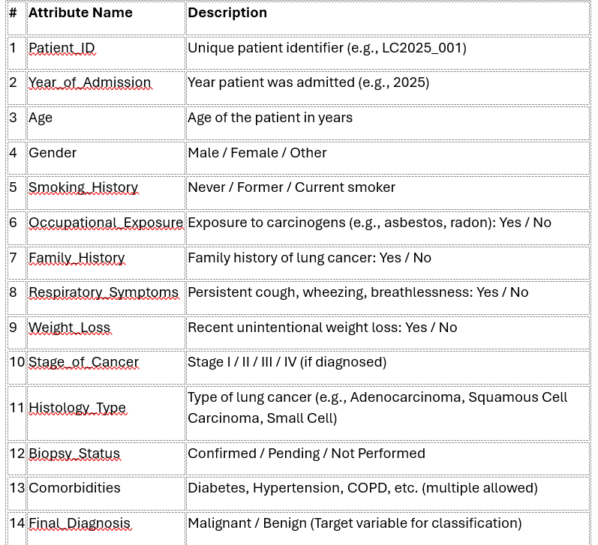
Project Description Patient Details Data set with 14 attributes Sample Table

Slide 11
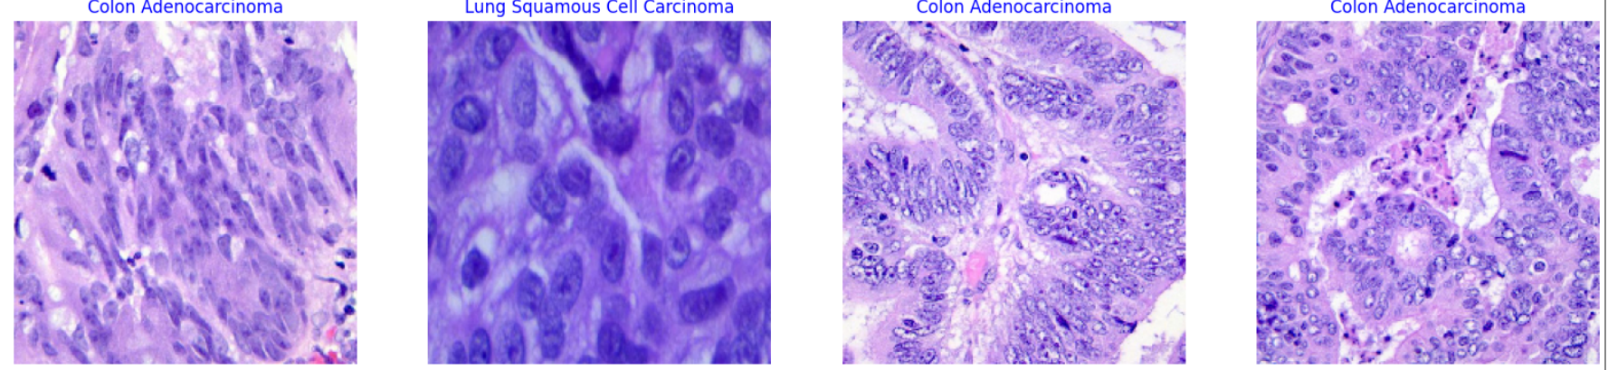
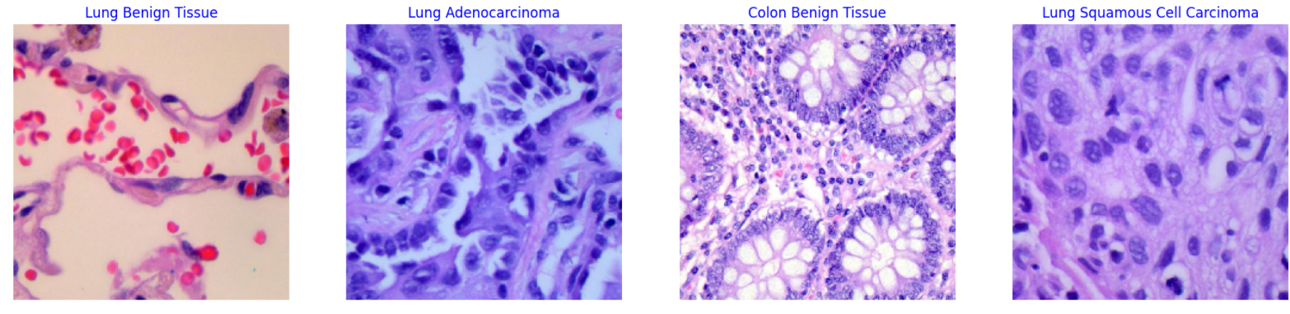
Project Description
Split data into train, valid, and test

Slide 12
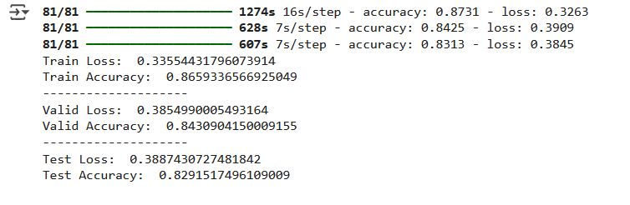
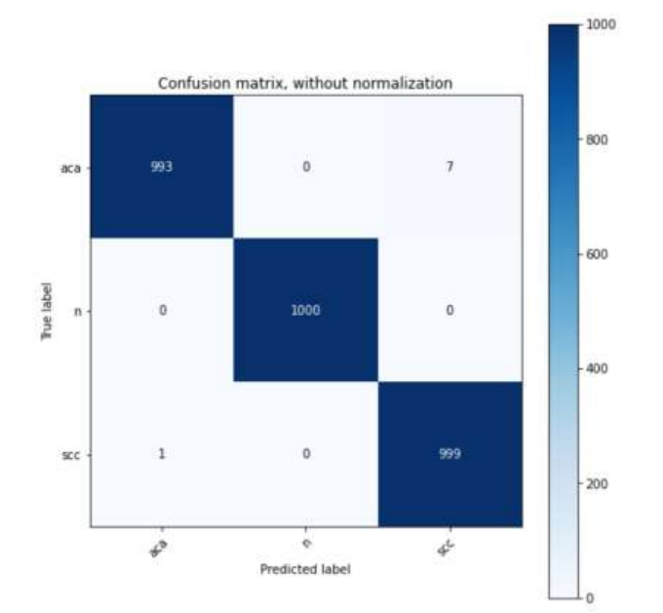
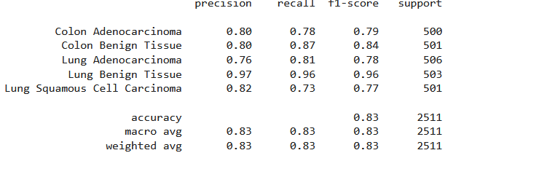
Project Description
Accuracy achieved

Slide 13
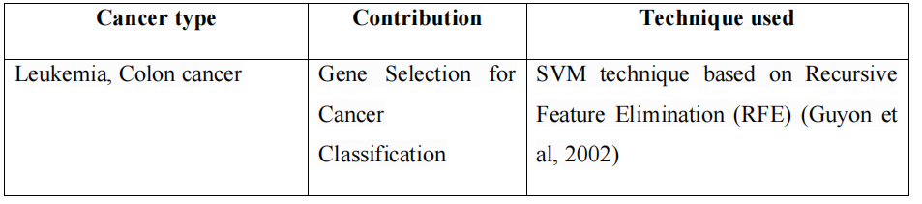
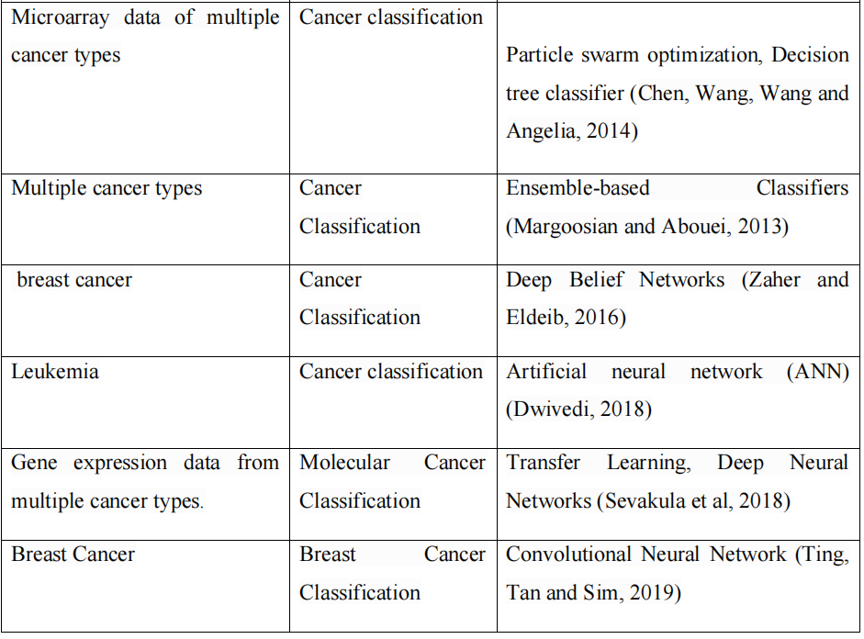
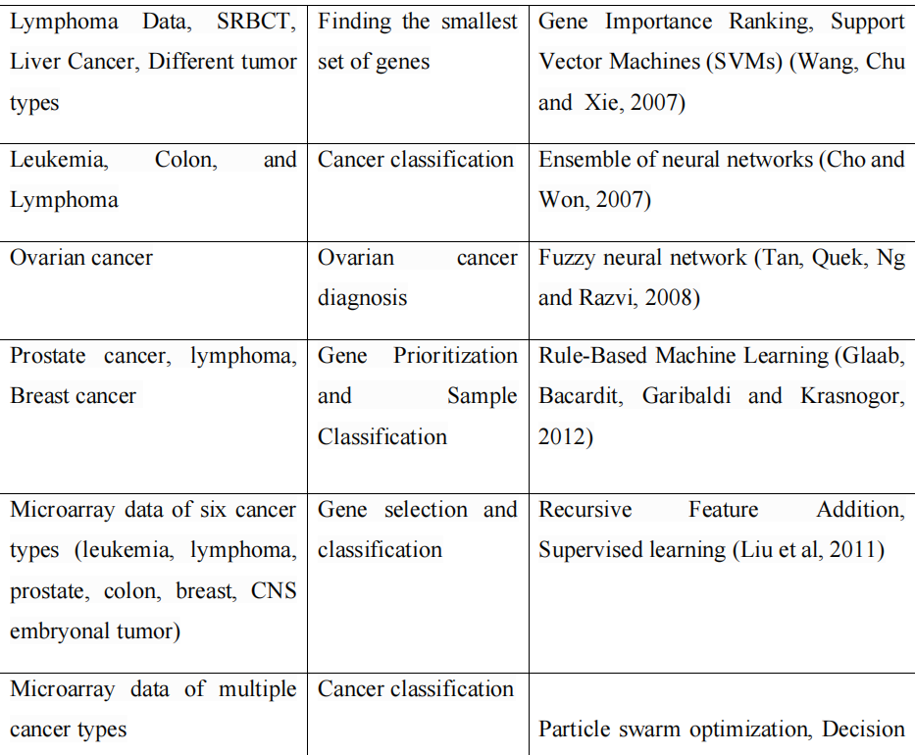
Project Description Analysis of Previous Research

Slide 14
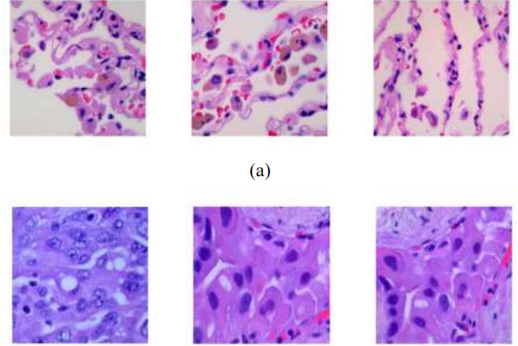
Project Description
Proposed Research Work
To classify the lung cancer images, the dataset is obtained from LC25000 Lung and colon
histopathological image dataset which is already augmented data having 5000 images in each
class of lung cancer image set comprising three classes. This dataset is pre-processed using
python tools and features are extracted by CNN techniques, later the model is created and
evaluated. Various CNN techniques are used to compare and classify the images. Complete
flow of proposed method is shown in Figure 4.

Slide 15
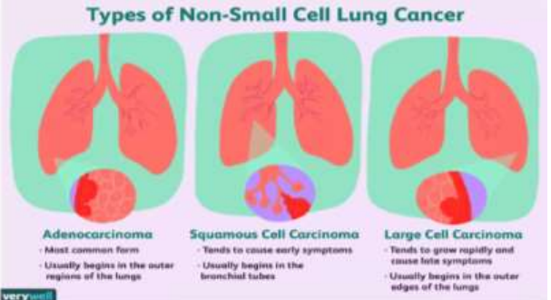
Project Description
Lung cancer is divided into two major types based on histology, biological behaviour,
prognosis and treatment. They are non-small cell lung cancer (NSCLC) and Small cell lung
cancer (SCLC). NSCLC is the most common cancer type, which accounts for 85% and the
remaining 15% is SCLC. NSCLC is again sub-divided into adenocarcinoma, squamous cell
carcinoma and large cell carcinoma. As shown in Figure 3, adenocarcinoma is the most
common cancer type and it is formed in epithelial cells that secrete mucus or fluids. Whereas
in squamous cell carcinoma, cancer originates from squamous cells that line many organs such
as the lung, bladder, kidney, intestines, and stomach (Pêgo-Fernandes, 2021; Cancer.gov,
2007).

Slide 16
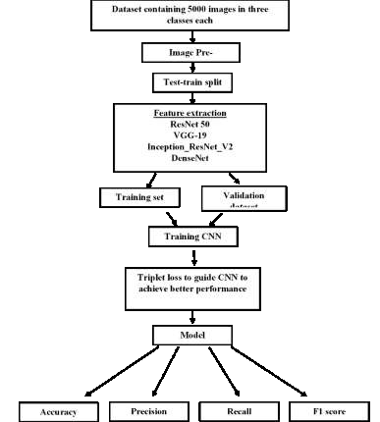
Project Description
Types of Non-Small Cell Lung Cancer (NSCLC) (Lynne Eldridge, 2021)

Slide 17
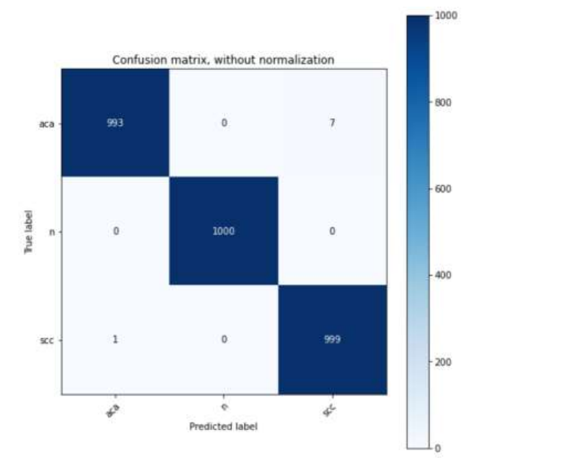
Project Description
Sample images of three classes present in the dataset. (a) lung_n (lung normal cells),
(b) lung_aca (lung adenocarcinoma cells) and (c) lung_scc (lung squamous cell carcinoma.

Slide 18
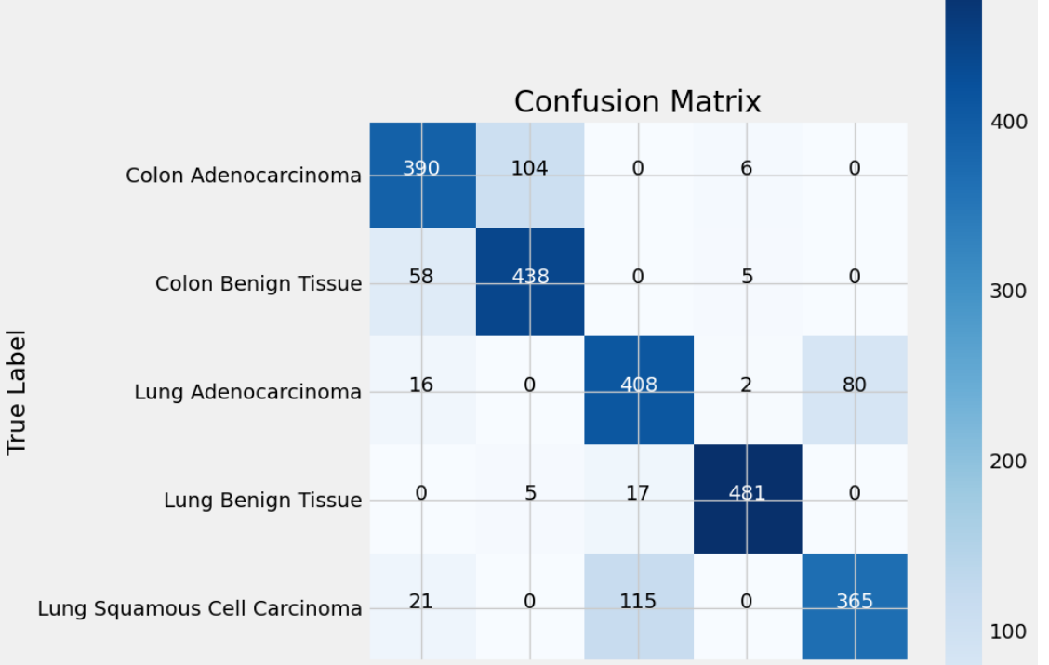
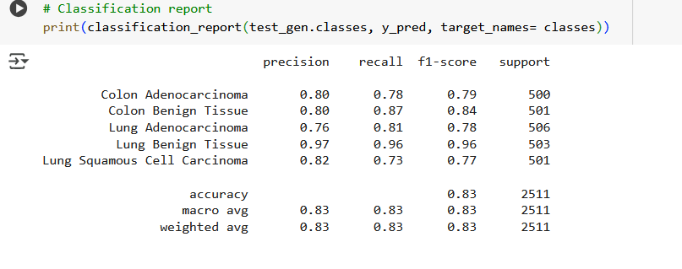
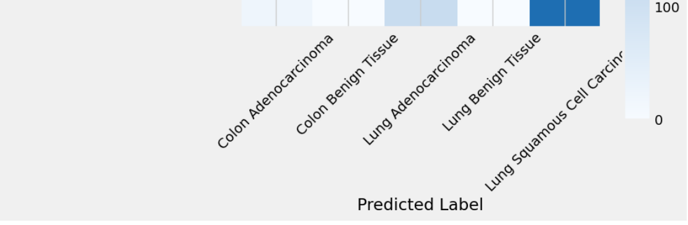
Project Description Confusion Matrics and Classification Report

Slide 19
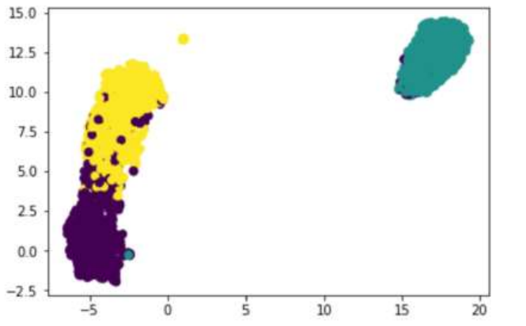
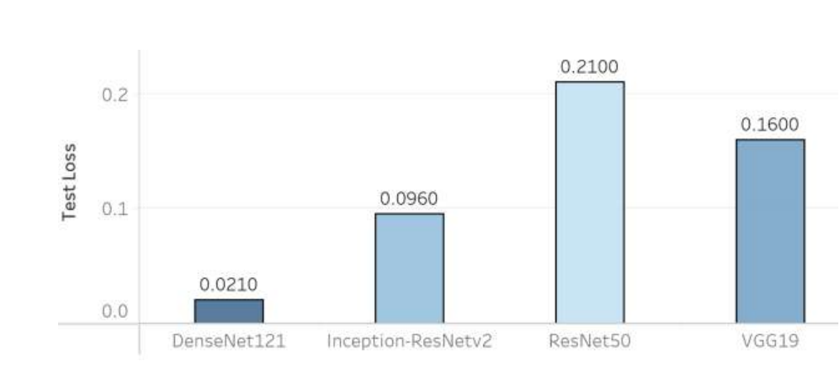
Project Description
Validation loss of four CNN architectures trained on triplet neural network.

Slide 20
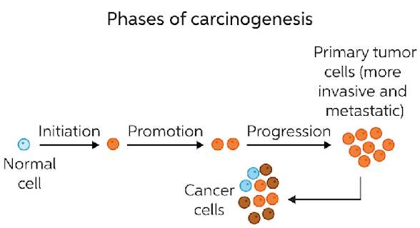
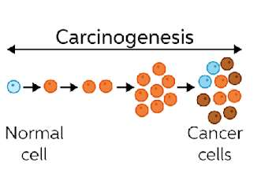
Process of carcinogenesis

Slide 21
Data – Set Used
Key Datasets and Their Characteristics:
Lung and Colon Cancer Histopathological Images:
This is a significant dataset containing 25,000 histopathological images.
It's categorized into five distinct classes:
Lung benign tissue.
Lung adenocarcinoma.
Lung squamous cell carcinoma.
Colon adenocarcinoma.
Colon benign tissue.
Each of these classes is represented by 5,000 images, all with a resolution of 768x768 pixels.
This dataset is valuable for training models to differentiate between various lung and colon tissue types, including both cancerous and non-cancerous samples.
Here is the link: https://www.kaggle.com/datasets/andrewmvd/lung-and-colon-cancer-histopathological-images
Cancer Dataset:
This dataset provides a different approach, focusing on CT scan slices.
It classifies cases into three categories: normal, benign, and malignant.
This dataset helps in the research of lung cancer detection using CT scan images.

Slide 22
Project Timeline
Data Preparation and Baseline Model (Weeks 1-4)
Advanced Techniques and Model Optimization (Weeks 5-8)
Thesis Review
completing
Research and Preparing Report
January 2025
February 2025
March 2025
April 2025
May 2025
Project proposal,
Knowing overview
Final evaluation and submission.

Slide 23
CONCLUSION
CNN models have shown to increase accuracy with fine tuning of hyper parameters. Various
CNN architectures are compared in the study to get better accuracy and to compare which
architecture gives better performance for this dataset. Model performance of all four CNN
models such as VGG19, ResNet50, Inception-ResNetv2 and DenseNet121 have shown
increased accuracy. Although the pre-trained models are available, fine-tuning of these models
are necessary to obtain desired results. In this study Inception-ResNetv2 has shown a very high_x0002_test accuracy rate of 99.7% when compared to other models where the accuracy of VGG19,
ResNet50 and DenseNet121 are 92,99 and 99.4% respectively. When the triplet neural network
model is trained on these four pre-trained models DenseNet121 achieved test accuracy of
99.08% which is the highest of all other four. Test accuracies of other three models are 97.69,
96.2, 97.04% for VGG19, ResNet50 and Inception-ResNetv2 respectively. The obtained model
with high accuracy has significantly classified cancer images from non-cancerous images
which is a crucial step in cancer diagnosis. There were no misclassifications among cancer and
non-cancer images. Only very few misclassifications happened among the two lung cancer
subtypes, that is adenocarcinoma and squamous cell carcinoma. Although the image aspect
ratio of image trained triplet neural networks is low, that is 128×128×3 and batch size is 16 due
to GPU constraints, the triplet network model has shown better performance.

Slide 24
References
[1] Agarwal, N., Balasubramanian, V. N., & Jawahar, C. V. (2018). Improving multiclass
classification by deep networks using DAGSVM and Triplet Loss. Pattern Recognition
Letters, 112, 184–190.
[2] Abdel-Zaher AM, Eldeib AM (2016) Breast cancer classification using deep belief
networks. Expert Syst Appl 46:139–144.
[3] Agarwal, N., Balasubramanian, V. N., & Jawahar, C. V. (2018). Improving multiclass
classification by deep networks using DAGSVM and Triplet Loss. Pattern Recognition
Letters, 112, 184–190.
[4] Akkus, Z., Ali, I., Sedlar, J., Agrawal, J. P., Parney, I. F., Giannini, C., & Erickson, B. J.
(2017). Predicting deletion of chromosomal arms 1p/19q in low-grade gliomas from MR
images using machine intelligence. Journal of Digital Imaging, 30(4), 469–476.
[5] Albarqouni S, Baur C, Achilles F, Belagiannis V, Demirci S, Navab N (2016) Aggnet:
deep learning from crowds for mitosis detection in breast cancer histology images. IEEE
Trans Med Imaging 35(5):1313–1321
[6] Bashiri, A., Ghazisaeedi, M., Safdari, R., Shahmoradi, L., & Ehtesham, H. (2017).
Improving the prediction of survival in cancer patients by using machine learning
techniques: Experience of gene expression data: A narrative review. Iranian Journal of
Public Health, 46(2), 165–172
[7] Bijaya Kumar Hatuwal, H.C.T., (2021) Lung Cancer Detection Using Convolutional
Neural Network on histopathological images. [online] Ijcttjournal.org. Available at:
http://www.ijcttjournal.org/archives/ijctt-v68i10p104 [Accessed 19 Jun. 2021].

Slide 25
References
[8] Borkowski, A.A., Bui, M.M., Thomas, L.B., Wilson, C.P., DeLand, L.A. and Mastorides,
S.M., (2019) Lung and Colon Cancer Histopathological Image Dataset (LC25000). arXiv
[eess.IV]. Available at: http://arxiv.org/abs/1912.12142 [Accessed 17 Jun. 2021].
[9] Bray, F., Ferlay, J., Soerjomataram, I., Siegel, R.L., Torre, L.A. and Jemal, A., (2018)
Global cancer statistics 2018: GLOBOCAN estimates of incidence and mortality
worldwide for 36 cancers in 185 countries. CA: a cancer journal for clinicians, 686,
pp.394–424.
P[10] Brennan, T.A., 2004. Medical malpractice. The New England Journal of Medicine,
350(3), p.283.
[11] Bron, E. E., Smits, M., van der Flier, W. M., Vrenken, H., Barkhof, F., Scheltens, P.,
Alzheimer’s Disease Neuroimaging Initiative. (2015). Standardized evaluation of
algorithms for computer-aided diagnosis of dementia based on structural MRI: the
CADDementia challenge. NeuroImage, 111, 562–579.
[12] Bukhari, S.U.K., Syed, A., Bokhari, S.K.A., Hussain, S.S., Armaghan, S.U. and Shah,
S.S.H., (2020) The histological diagnosis of colonic adenocarcinoma by applying partial
self supervised learning. bioRxiv, p.2020.08.15.20175760.
[13] Cancer.gov (2007) What Is Cancer? [online] Available at:
https://www.cancer.gov/about-cancer/understanding/what-is-cancer [Accessed 10 Jun.
2021].
[14] Causey, J. L., Zhang, J., Ma, S., Jiang, B., Qualls, J. A., Politte, D. G., … Huang, X.
(2018). Highly accurate model for prediction of lung nodule malignancy with CT scans.
Scientific Reports, 8(1), 9286.

Slide 26
References
[21] Ding J, Zhou S, Guan J (2010) Mirensvm: towards better prediction of microrna
precursors using an ensemble svm classifier with multi-loop features. BMC Bioinf
11(11):1
[22] Doi, K. (2007). Computer-aided diagnosis in medical imaging: historical review,
current status and future potential. Computerized Medical Imaging and Graphics: The
Official Journal of the Computerized Medical Imaging Society, 31(4–5), 198–211.
[23] Dwivedi AK (2018) Artificial neural network model for effective cancer classification
using microarray gene expression data. Neural Comput Appl 29(12):1545–1554
[24] Ehteshami Bejnordi, B., Veta, M., Johannes van Diest, P., van Ginneken, B.,
Karssemeijer, N., Litjens, G., … and the CAMELYON16 Consortium. (2017). Diagnostic
assessment of deep learning algorithms for detection of lymph node metastases in women
with breast cancer. JAMA: The Journal of the American Medical Association, 318(22),
2199.[25] Eldridge, L., (2021) The most common types of lung cancer. [online]
Verywellhealth.com. Available at: https://www.verywellhealth.com/what-is-the-most_x0002_common-type-of-lung-cancer-2249359 [Accessed 16 Jun. 2021].
[26] Elnakib, A., M. Amer, H. and E.Z. Abou-Chadi, F., (2020) Early lung cancer detection
using deep learning optimization. International Journal of Online and Biomedical
Engineering (iJOE), 1606, p.82.
[27] Fatima, M., & Pasha, M. (2017). Survey of machine learning algorithms for disease
diagnostic. Journal of Intelligent Learning Systems and Applications, 09(01), 1–16.
[28] Ferlay, J., Colombet, M., Soerjomataram, I., Parkin, D.M., Piñeros, M., Znaor, A. and
Bray, F., (2021) Cancer statistics for the year 2020: An overview. International journal of
cancer. Journal international du cancer.
[29] Fischer, A.H., Jacobson, K.A., Rose, J. and Zeller, R., (2008) Hematoxylin and eosin

Slide 27
THANK YOU

